Slide 1
Session 3
Pebertli Nils

Slide 2
Task Coding - Image Region of Interest Task
Code Available in GitHub - pebertli/automatic_ad
3 Jupyter Notebooks and a few modules
task_1_gradcam.ipynb addresses the problem as requested
task_1_florence.ipynb uses a different method to detect the region of interest in the input image, namely Florence-2
task_1_outpaint.ipynb does not resize images to fit the window and canvas, but outpaint missing parts of the input image to fill the whole canvas in a meaningful way
All the notebooks goes with generated outputs but please take a time to try by yourself

Slide 3
Task Coding - Image Region of Interest Task
Some considerations on RoI detection
threshold of the heatmap is too prone to noise. Consider an adaptative threshold or region separation
region of interest using a zero-shot object detection like florence2 then a second task thas ask which objects makes sense to the prompt.
finetuning a model, such as florence2 for the segmentation of the region of interest specifically for product ads
if the image is smaller than the canvas and ROI is also large, it might be impossible to fulfil the requirements of keep the ROI inside the Window
An ill combination of canvas and ROI might result in the window not containing the RoI at all.
I will discuss those cases

Slide 4
Task Coding - Image Region of Interest Task
Some considerations on Oupaint Proposal
A better prompt engineering might fix many issues there
Text completion might be an issue, though
Inference time in total is 12 seconds for Florence interrogator on CPU plus SD Inpaint on GPU

Slide 5
Task Design
Pipeline to generate backgrounds for product images
Addressing Requirements
Proposal
Pipeline
Deployment Considerations
High level Development Plan
Demo
Pipeline available in the repo GitHub - pebertli/automatic_ad

Slide 6
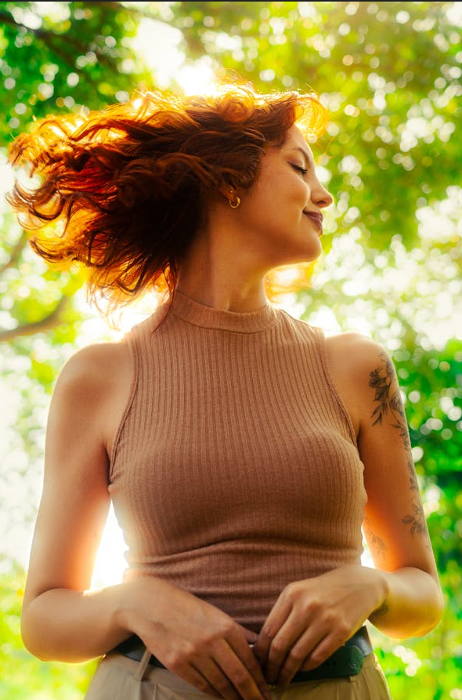
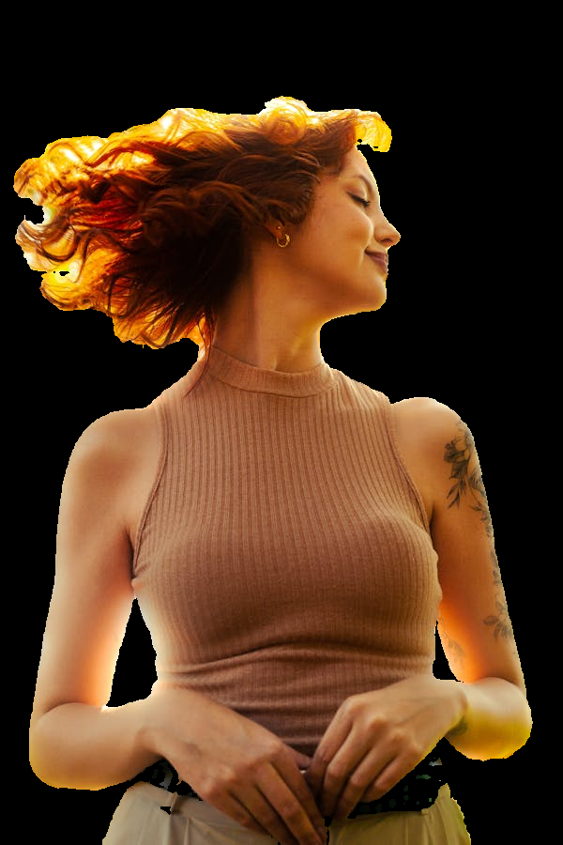
Addressing Requirements
Background removal/product isolation
Automatic background using the prompt and the image as input. A zero-shot model such GroundingDino and SAM might help on this task, but still not perfect

Slide 7
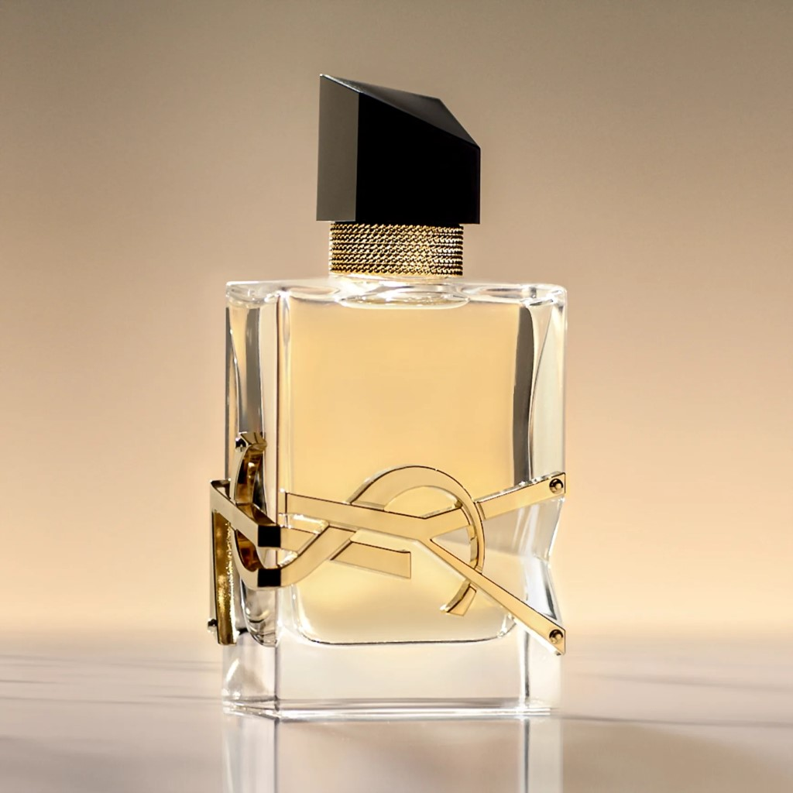
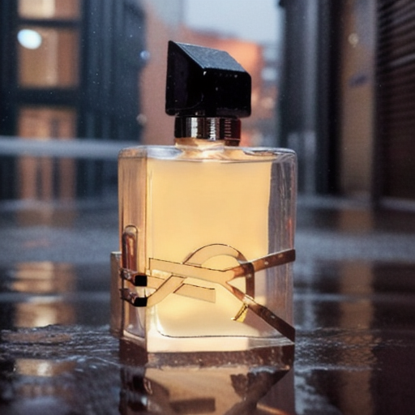
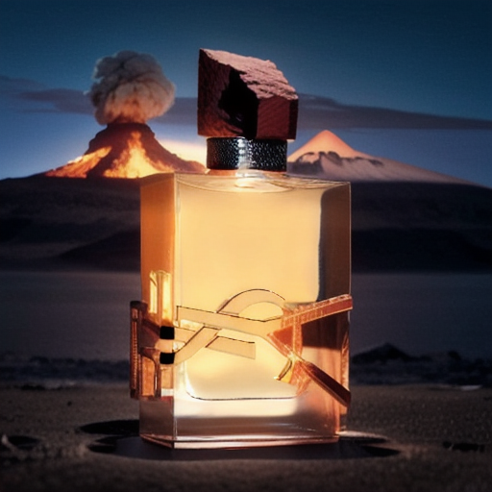
Addressing Requirements
Blending
Light, transparency, reflections but still keep the original shape, info, etc

Slide 8
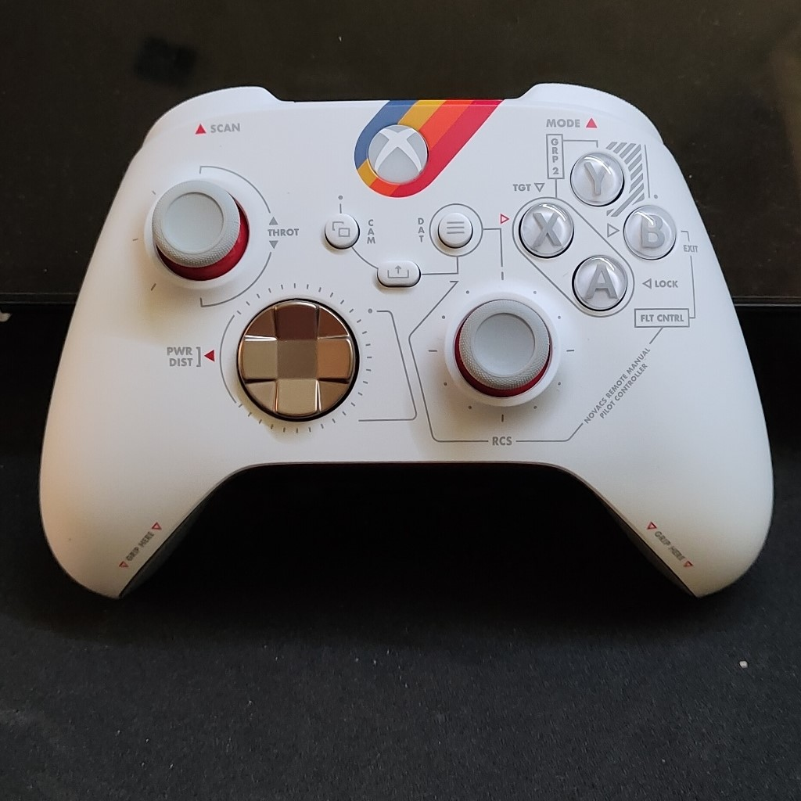
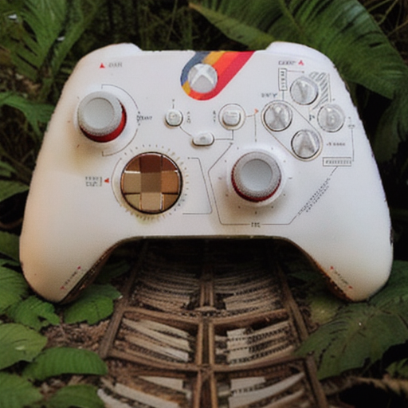
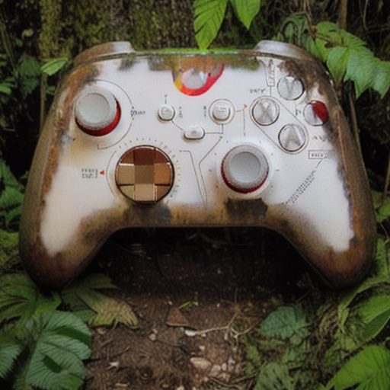
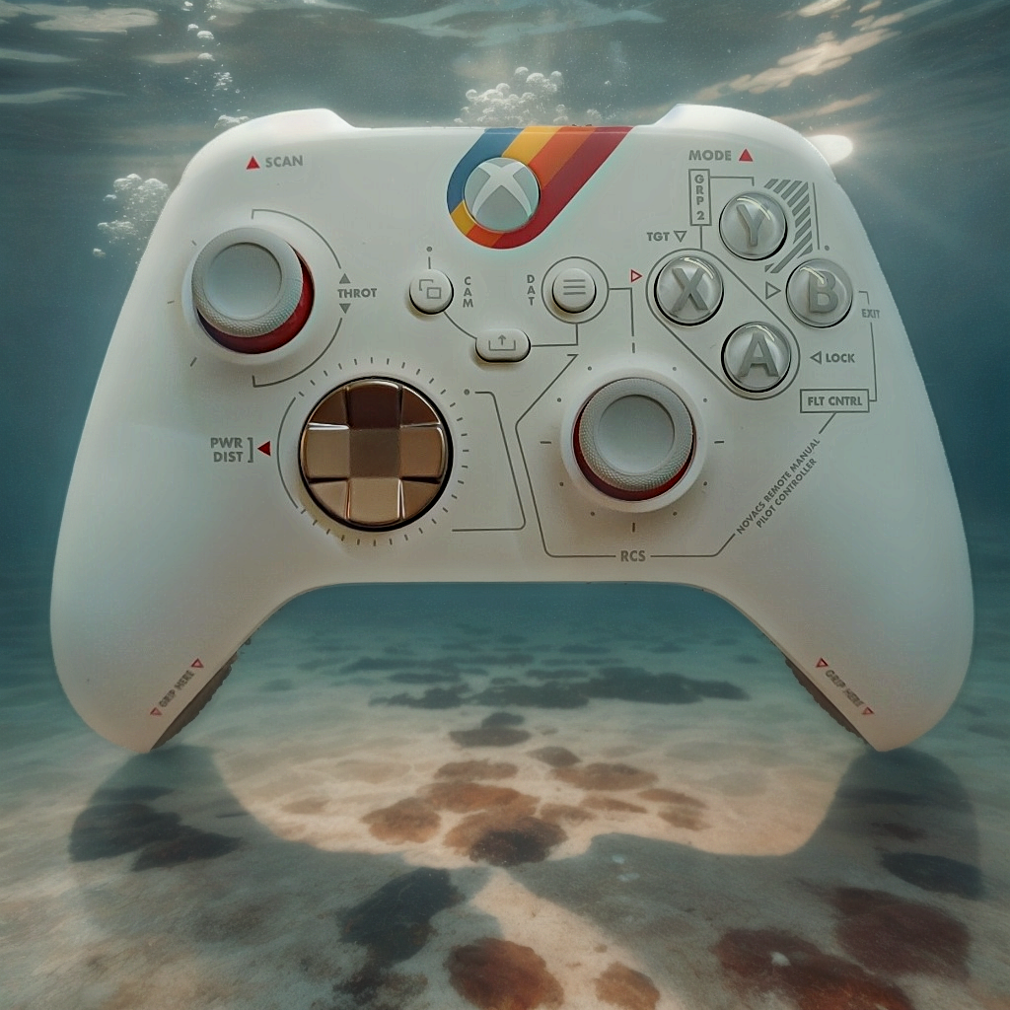
Addressing Requirements
Fidelity
- Usually, keep crucial info of the product while blend it with a new background is a trade-off between fidelity and creativity.

Slide 9
Proposal
One shot advanced proposal
Automatic Background removal, background generation, image composition, relight
Advantages
One single pipeline
Easy to implement
Fast and light
Limitations
Many parameters to tweak
Does not work well for complex cases
Lora proposal
Finetune the SD model with the product
Advantages
Novel view poses
More complex compositions (a woman holding a perfume bottle)
Less models in the pipeline
- limitations
Requires more images
Requires more time to train
Outro
3D reconstruction of the product for more advanced uses cases
Multiple pipelines that are automatic chosen according to the type of the product image

Slide 10
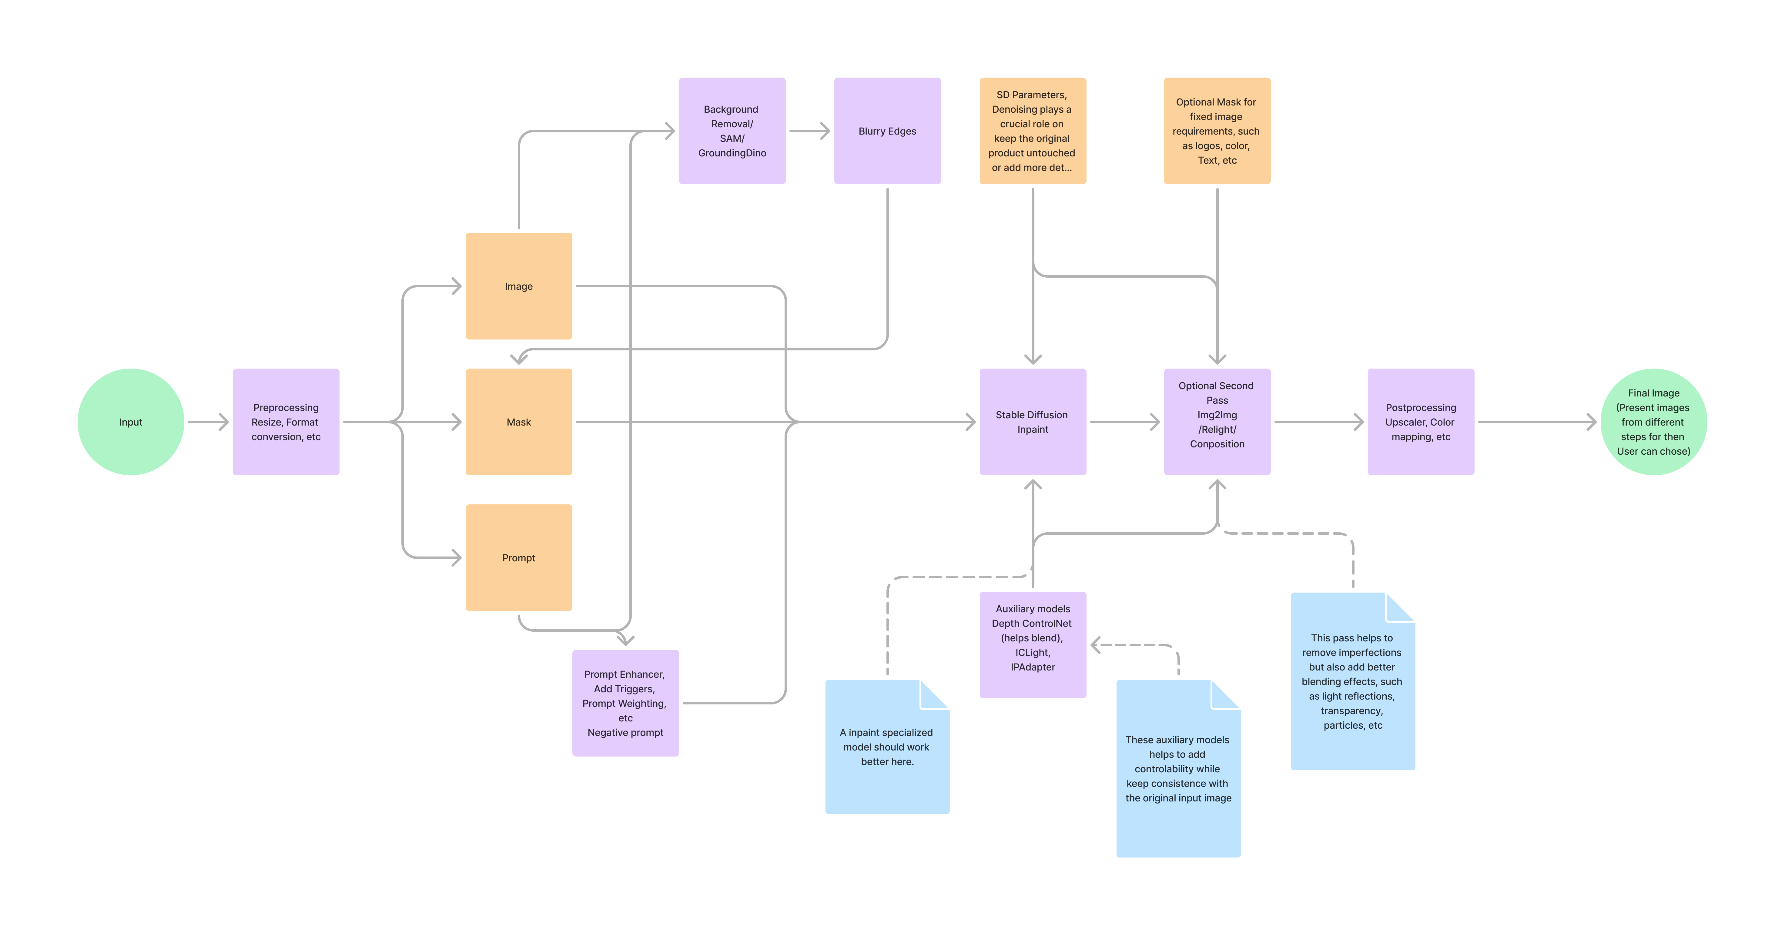
Pipeline

Slide 11
Deployment Considerations
Recommended frameworks:
ComfyUI, Automatic1111, Diffusers
A suggestion of the pipeline is included in the github of this task pebertli/automatic_ad (github.com)
Models are referenced there, and they are all free for commercial usage, including controlnet, iclight, Stability SD, GroundingDino and SAM
Deployment considerations:
A 16 GB gpu and 32 RAM should be enough to run this pipeline
A first run will load the models and takes around 45 seconds in a RTX 4090. Ater this, each run takes around 20 seconds for the full pipeline

Slide 12
High level Development Plan
Spikes for important stages of the pipeline
Background removal
Background generation (SD 1.5?, SDXL?, Finetuned models?, Paid models? Prompt Engineering)
Image blending (ControlNet, IpAdapter, ICLight, etc)
Development using available frameworks
Test with use cases
This could include a user-acceptance test
Deployment
It might involve different times depending on the framework and models chosen
5-8 weeks

Slide 13
Demo

